Slide 1
Lab on Cell-free Synthetic Biology

Slide 2
Course content
Basic molecular biology experiments (Week2-4)
Plasmid transformation
Protein expression
PCR
Protein Purification
Cell-free protein expression
Onepot PURE purification (Week 5-7)
Ribosome purification (Week 8-9)
PURE reaction
Project (Week 10-12)

Slide 3
Lab
Cell-free
on
Synthetic Biology

Slide 4
Synthetic Biology
Synthetic biology is a field of science that involves redesigning organisms for useful purposes by engineering them to have new abilities.

Slide 5
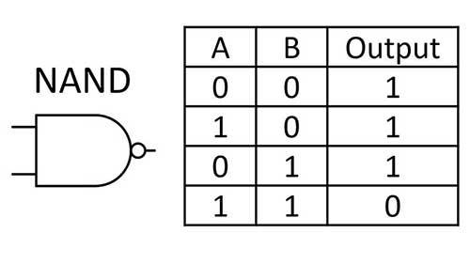
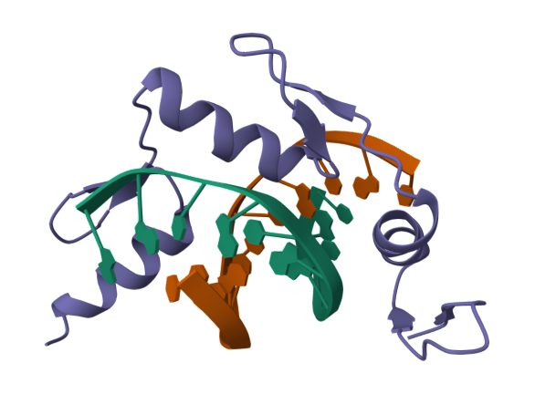
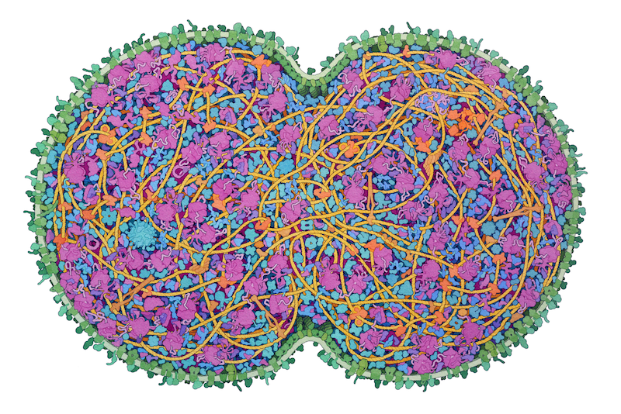
Synthetic Biology
Parts
Systems
Organism

Slide 6
Synthetic Biology
Parts
Systems
Organism

Slide 7
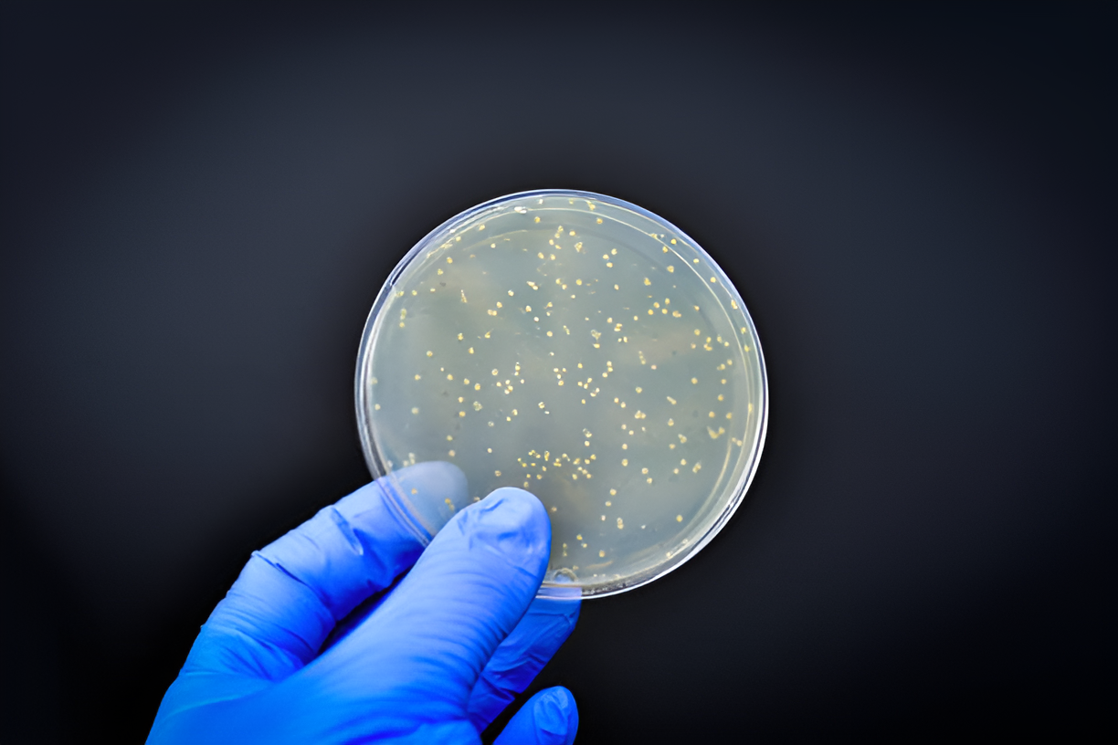

Slide 8
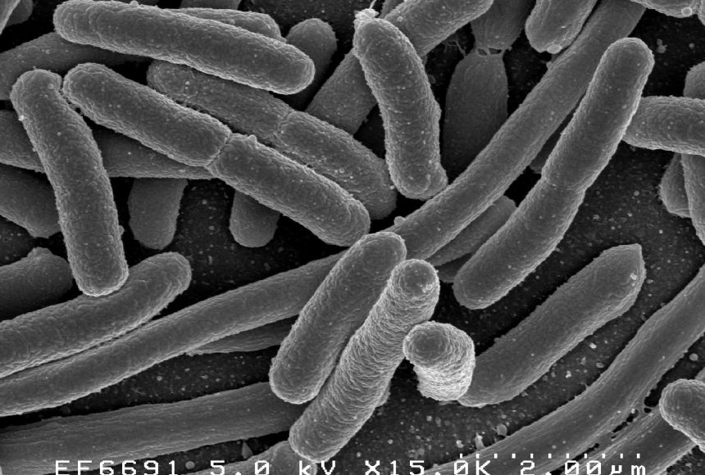

Slide 9
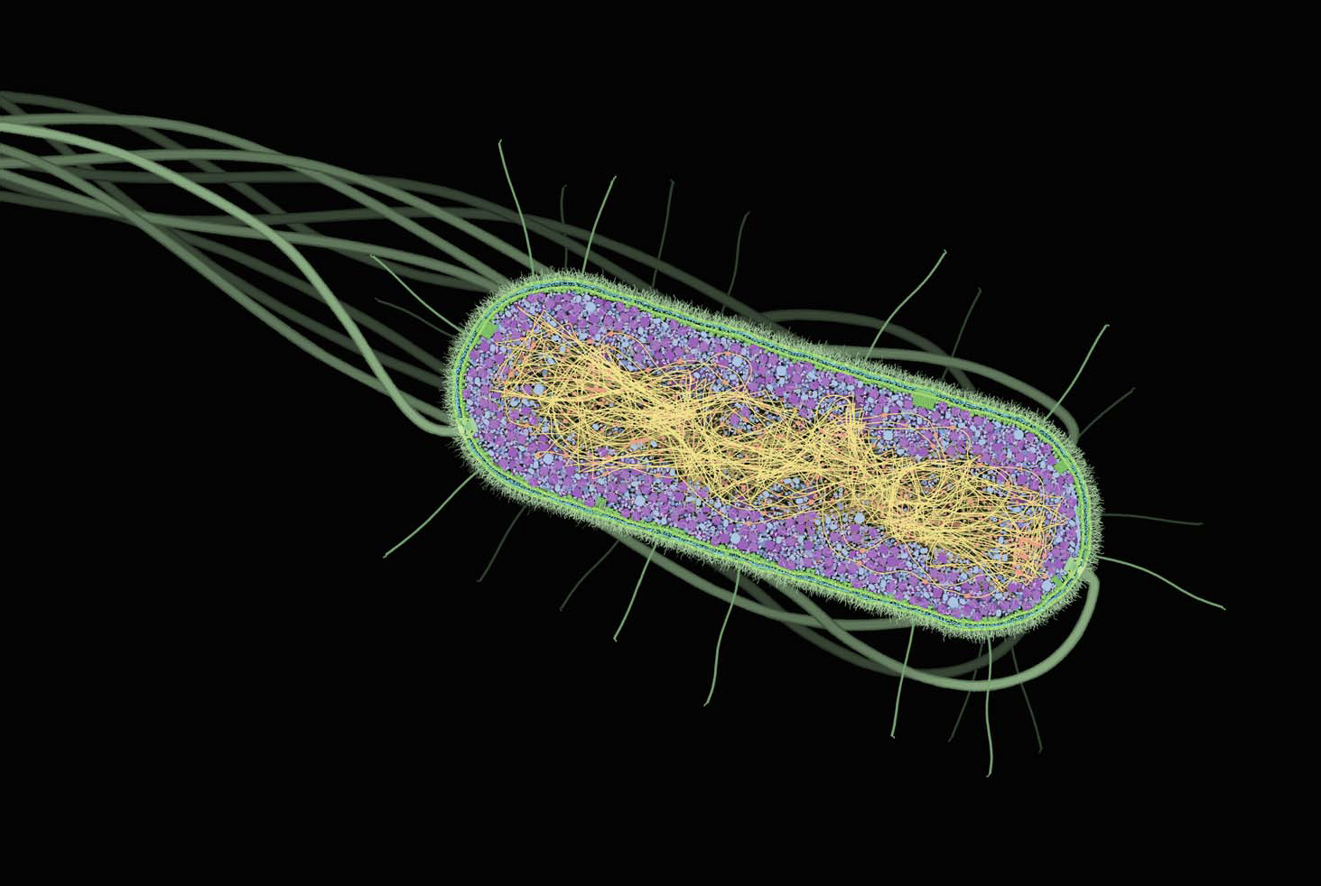
David S. Goodsell - The Machinery of Life-Copernicus Books

Slide 10
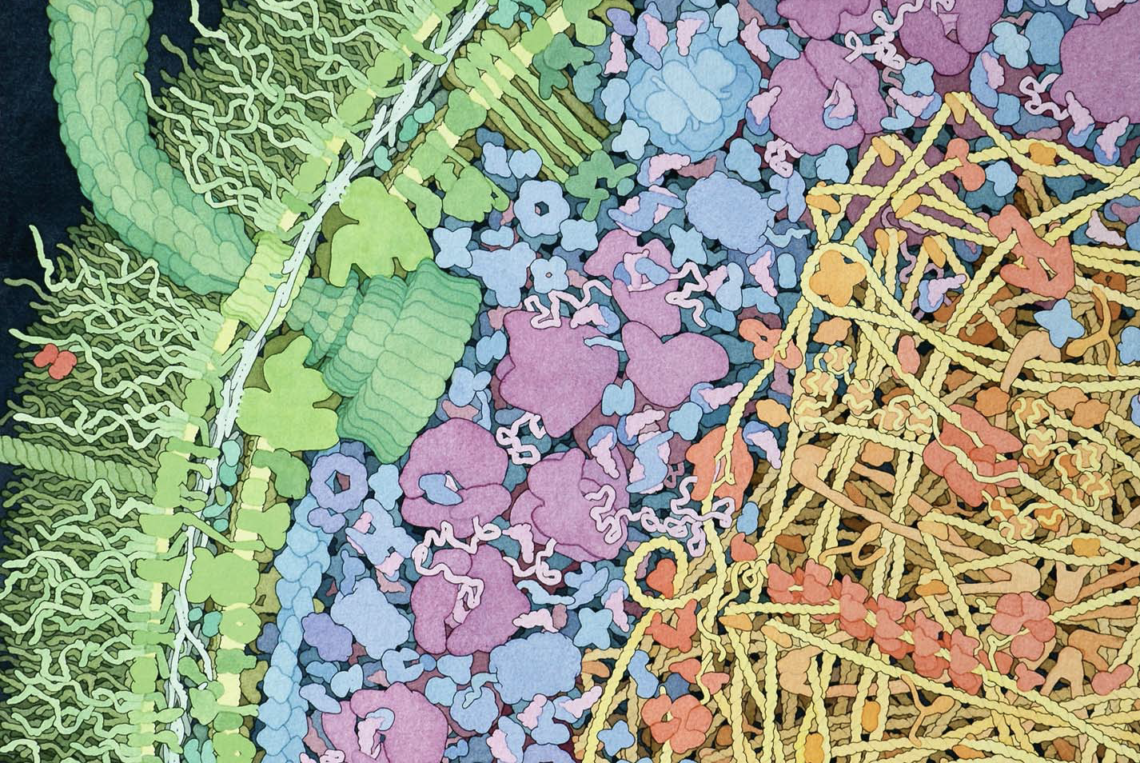
David S. Goodsell - The Machinery of Life-Copernicus Books

Slide 11
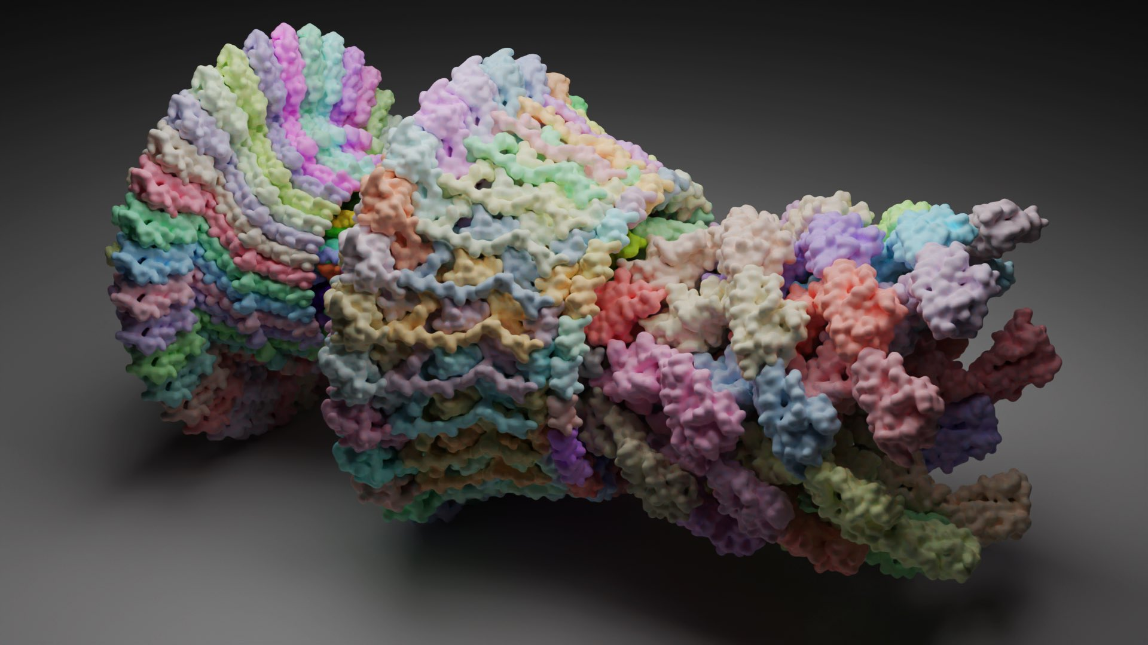
https://twitter.com/bradyajohnston

Slide 12
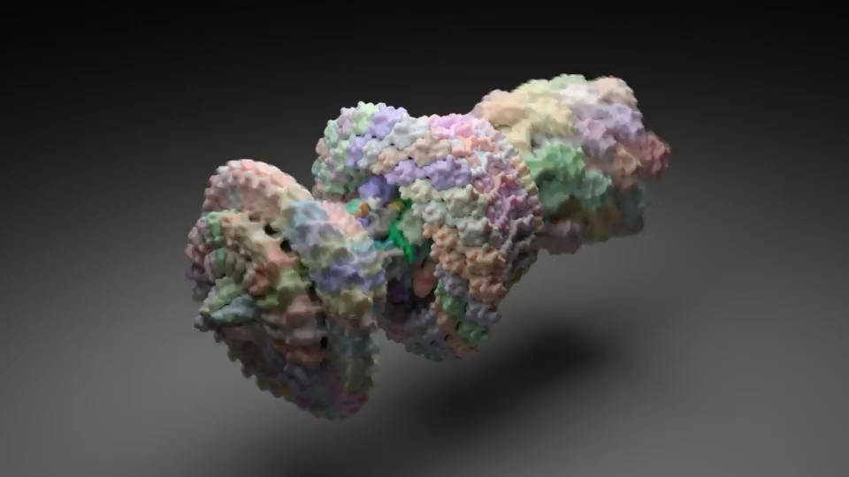
https://twitter.com/bradyajohnston

Slide 13
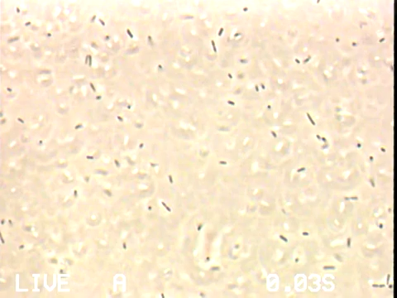

Slide 14
https://twitter.com/bradyajohnston

Slide 15
David S. Goodsell - The Machinery of Life-Copernicus Books
Notes:
All the proteins are functional unit, how to engineer them? How to make them express in E coli

Slide 16
Engineering Parts
How to express protein of interest?
When to express proteins?
How to design proteins?

Slide 17
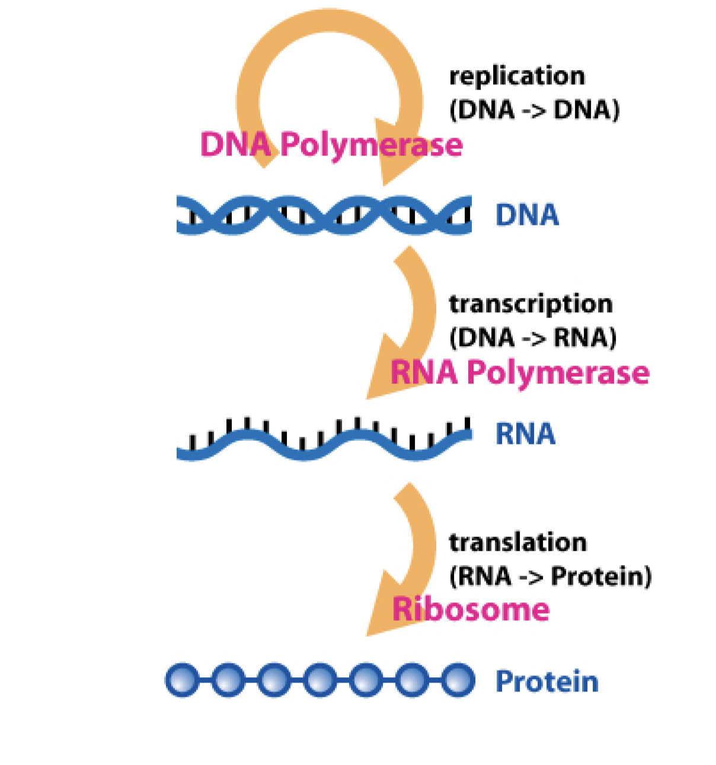
Central dogama

Slide 18
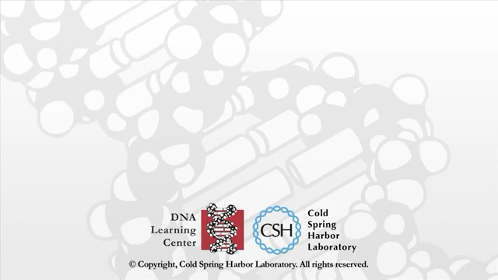
Notes:
20sec-41sec
1:56 translation

Slide 19
Components required for trascnription translation
DNA
RNA polymerase
NTPs
Ribosome
tRNA
Amino acids
Translational proteins

Slide 20
David S. Goodsell - The Machinery of Life-Copernicus Books

Slide 21
Design a DNA template to express protein
TAATACGACTCACTAT
AGGAGG

Slide 22
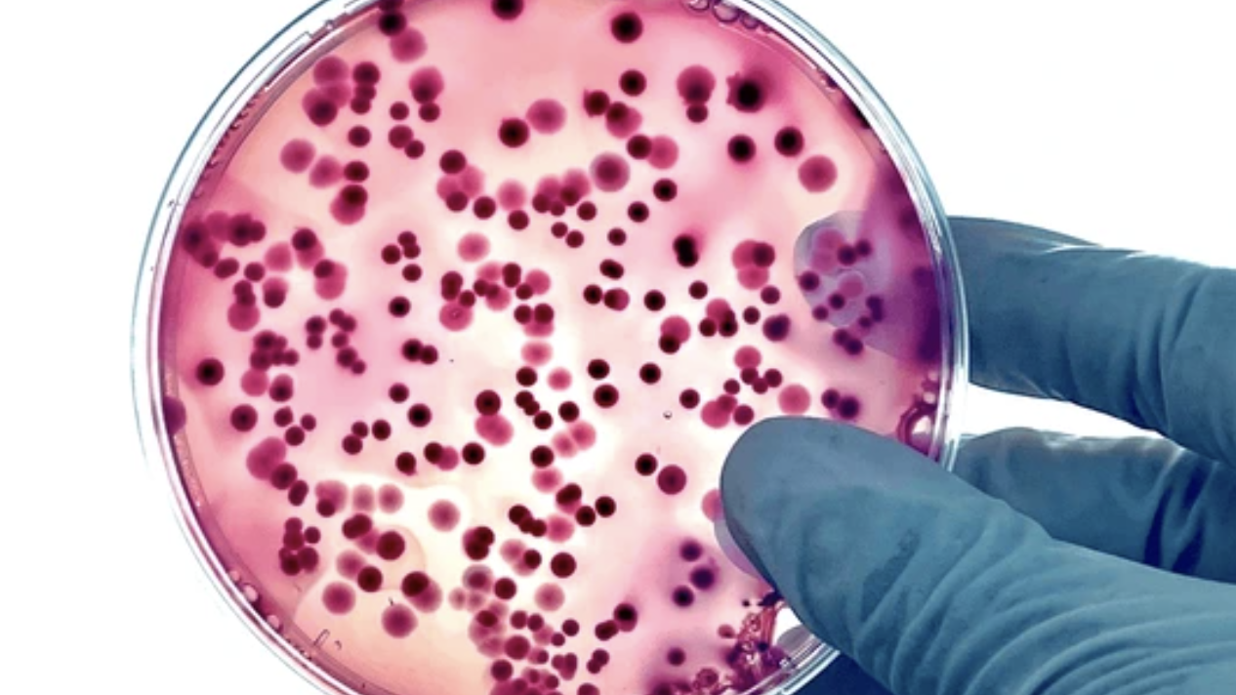

Slide 23
Design a DNA template to express protein
TAATACGACTCACTAT
AGGAGG

Slide 24
Design a DNA template to express protein
TAATACGACTCACTAT
AGGAGG

Slide 25
Design a DNA template to express protein
TAATACGACTCACTAT
AGGAGG

Slide 26
Regulate protein expression
Repressor
Operator
TAATACGACTCACTAT
AGGAGG

Slide 27
Regulate protein expression
Operator
TAATACGACTCACTAT
AGGAGG

Slide 28
Regulate protein expression
Inducer
Operator
TAATACGACTCACTAT
AGGAGG

Slide 29
Regulate protein expression
Operator
TAATACGACTCACTAT
AGGAGG

Slide 30
Regulate protein expression
Repressor : LacI
Inducer : IPTG
Operator
TAATACGACTCACTAT
AGGAGG

Slide 31
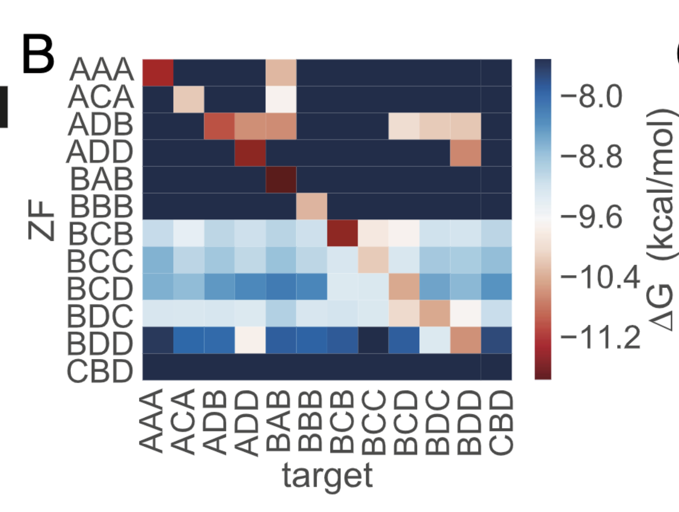
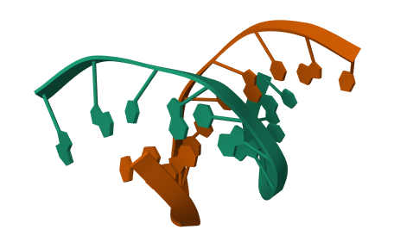
Zinc Finger protein
Swank, Z., Laohakunakorn, N., & Maerkl, S. J. (2019). Cell-free gene-regulatory network engineering with synthetic transcription factors. Proceedings of the National Academy of Sciences, 116(13), 5892-5901.

Slide 32
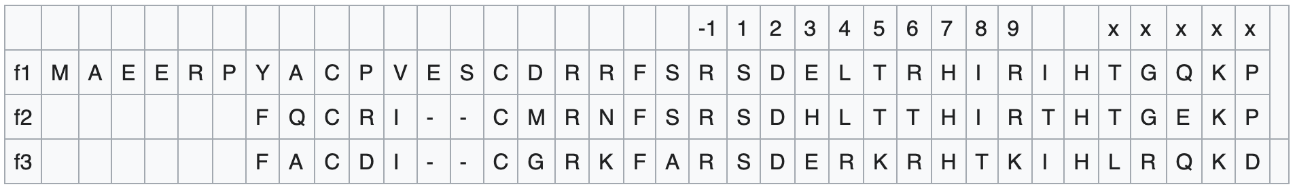
How to design protein (Zinc finger)?
Amino Acid sequence
DNA binding part

Slide 33
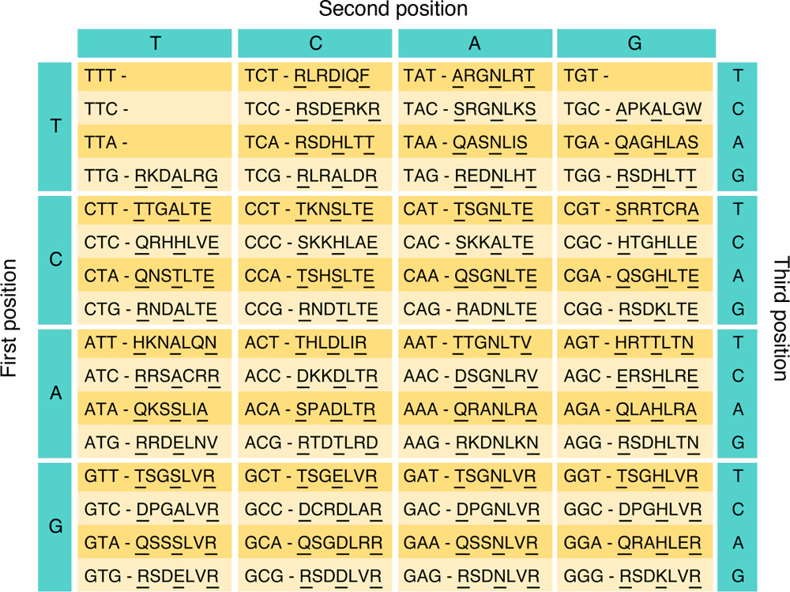
Gersbach, C. A., Gaj, T., & Barbas III, C. F. (2014). Synthetic zinc finger proteins: the advent of targeted gene regulation and genome modification technologies. Accounts of chemical research, 47(8), 2309-2318.

Slide 34
Operator
Zinc Finger (ATAGGCTAG)
Operator
Zinc Finger (ATAGGCTAG)

Slide 35
Application of Zinc finger
ZF BS 1
ZF BS 2

Slide 36
Application of Zinc finger – Programmable repressor
ZF BS 1
ZF BS 2

Slide 37
Application of Zinc finger – Programmable repressor
ZF BS 2
ZF BS 1
Zinc Finger 3

Slide 38
Application of Zinc finger – Programmable repressor
ZF BS 2
ZF BS 1
Zinc Finger 3

Slide 39
More informations
IGEM parts
De novo protein design (David Baker, Bruno Correia….)
AlphaFold, RosettaFold, RFDiffusion

Slide 40
Synthetic Biology
Parts
Systems
Organism

Slide 41
Synthetic Biology
Parts
Systems
Organism

Slide 42
Repressilator
Elowitz, M. B., & Leibler, S. (2000). A synthetic oscillatory network of transcriptional regulators. Nature, 403(6767), 335-338.

Slide 43
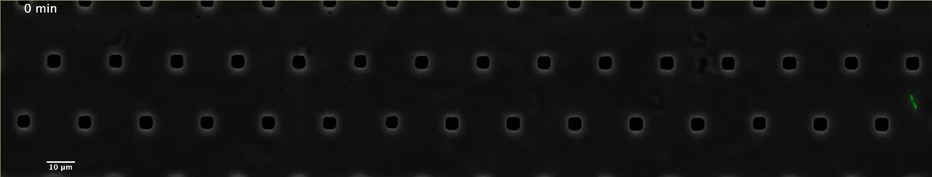
sd
Niederholtmeyer, H., Sun, Z. Z., Hori, Y., Yeung, E., Verpoorte, A., Murray, R. M., & Maerkl, S. J. (2015). Rapid cell-free forward engineering of novel genetic ring oscillators. elife, 4, e09771.

Slide 44
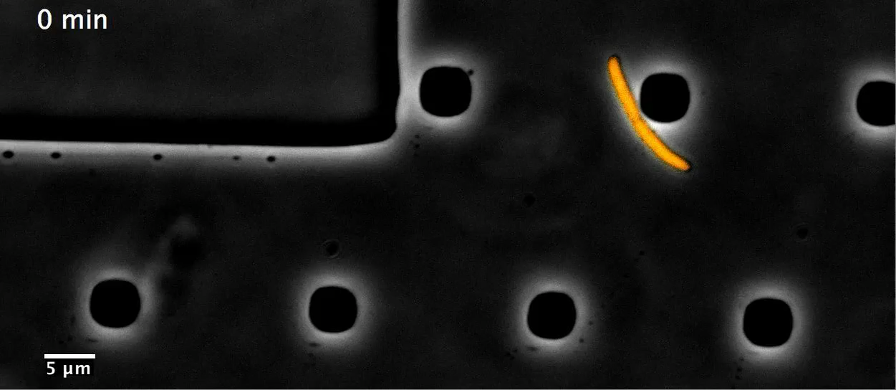
sd
Niederholtmeyer, H., Sun, Z. Z., Hori, Y., Yeung, E., Verpoorte, A., Murray, R. M., & Maerkl, S. J. (2015). Rapid cell-free forward engineering of novel genetic ring oscillators. elife, 4, e09771.

Slide 45
Synthetic Biology
Parts
Systems
Organism

Slide 46
Synthetic Biology
Parts
Systems
Organism

Slide 47
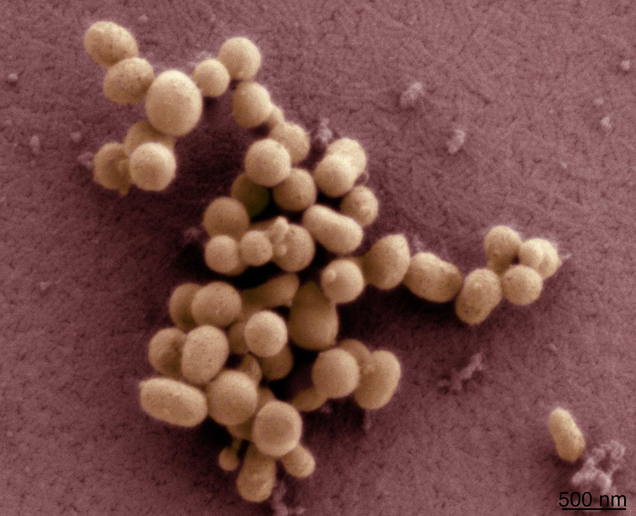
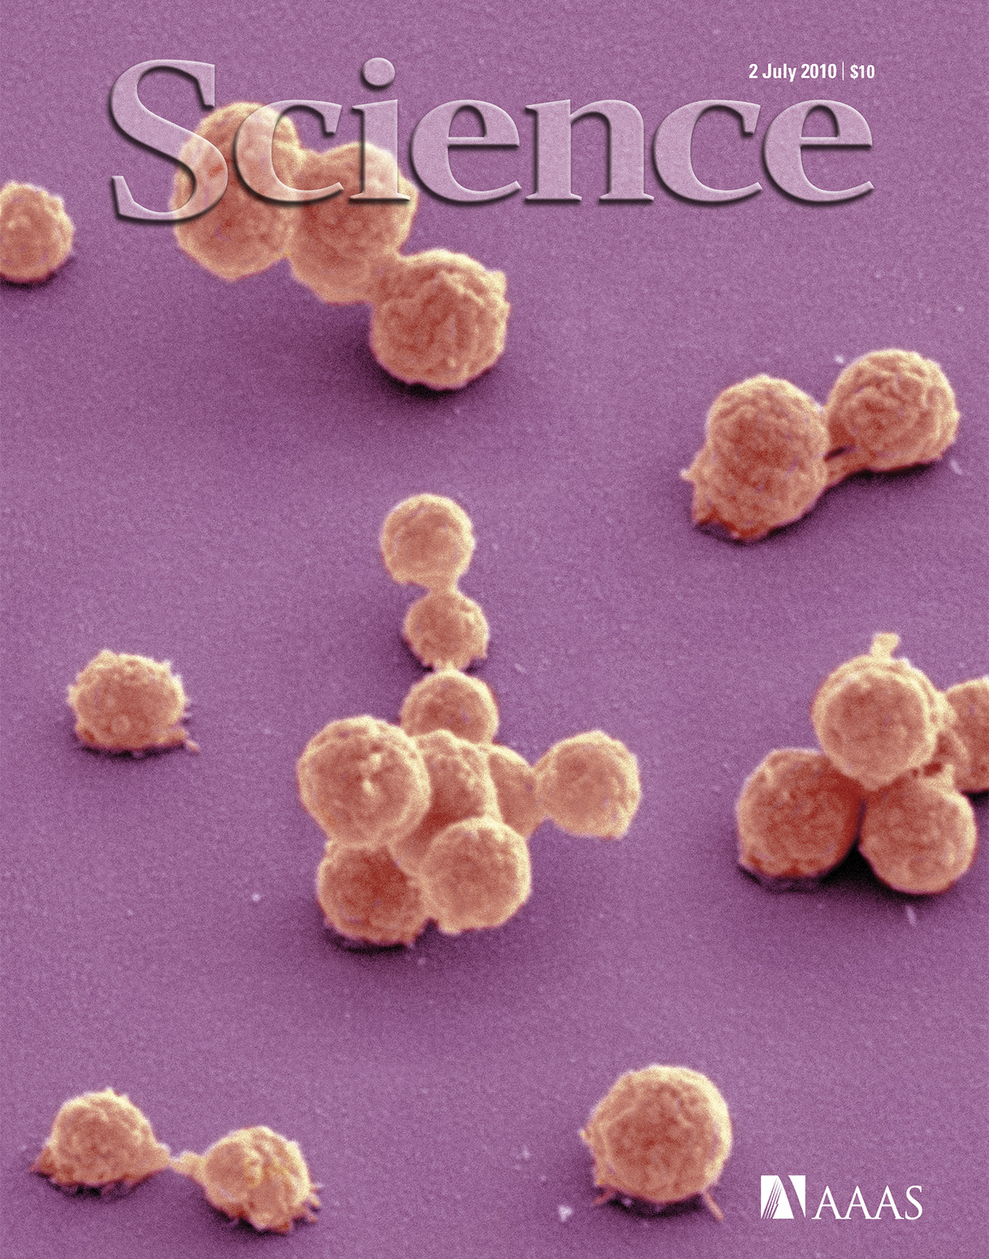
2010
2016
Mycoplasma mycoides
JCVI-syn1.0
(synthetic genome)
JCVI-syn3.0
~1000 genes
473 genes
Hutchison III, Clyde A., et al. "Design and synthesis of a minimal bacterial genome." Science 351.6280 (2016): aad6253.

Slide 49
Can we build a cell from bottom-up approach?
PURE
Protein synthesis Using Recombinant Elements
Proteins the can make proteins

Slide 50
non ribosomal proteins
Shimizu, Yoshihiro, et al. "Cell-free translation reconstituted with purified components." Nature biotechnology 19.8 (2001): 751-755

Slide 51
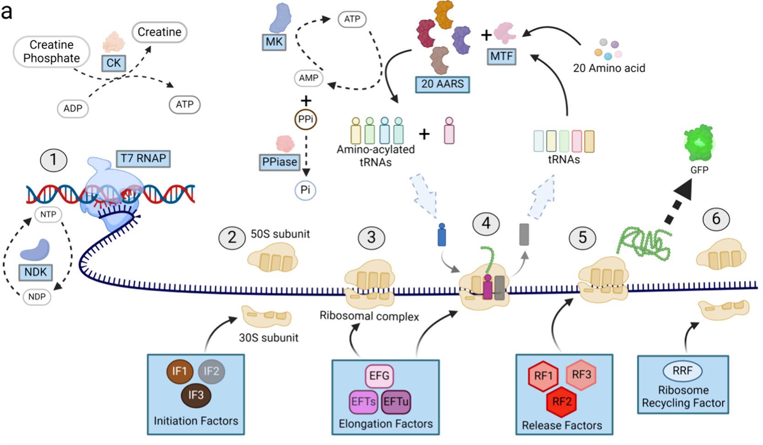
Ganesh, R. B., & Maerkl, S. J. (2024). Towards Self-regeneration: Exploring the Limits of Protein Synthesis in the Protein Synthesis Using Recombinant Elements (PURE) Cell-free Transcription–Translation System. ACS Synthetic Biology.

Slide 52
Lab
Cell-free
on
Synthetic Biology

Slide 53
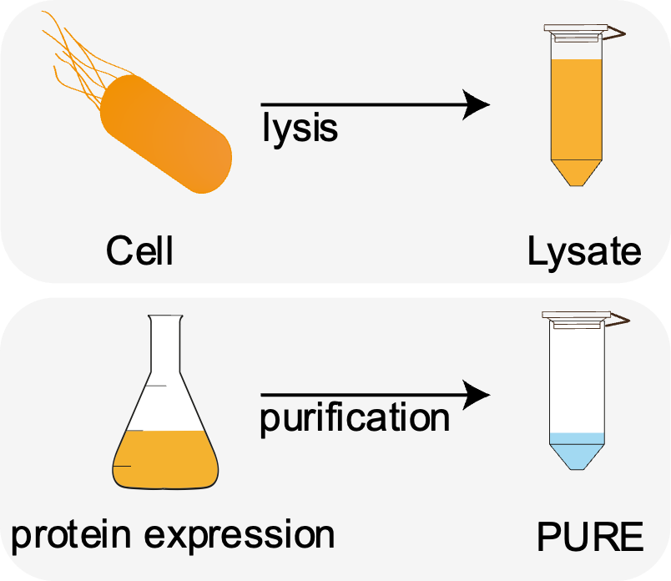
Cell-free
Protein Synthesis
Synthesis protein without living cells
Take the cellular transcription / translation out of the cell

Slide 54
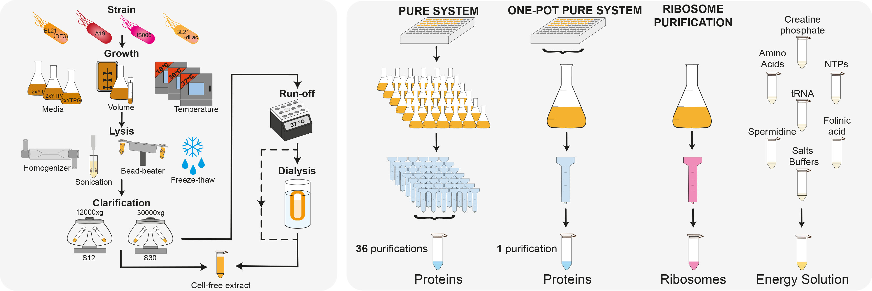
Lysate vs PURE
Lysate
PURE
adapted from: Laohakunakorn et al., Frontiers in Bioengineering and Biotechnology, 2020

Slide 55
Lysate vs PURE
Lysate
PURE
Has been around forever
High yield
Cheap and easy to make
Many different systems available
Undefined and complex
→ Black box
Since 2001
Less active
Expensive and laborious to make
Only E. coli based
Well-defined and comparably well understood
→ Less of a black box

Slide 56
Set up a PURE reaction
DNA
Ribosome
36 non-ribosomal
protein
Energy Solution

Slide 57
Applications
Basic science: understanding biological systems better
Rapid prototyping
Diagnostics
Therapeutics
Building a synthetic cell
Tinafar 2019

Slide 58
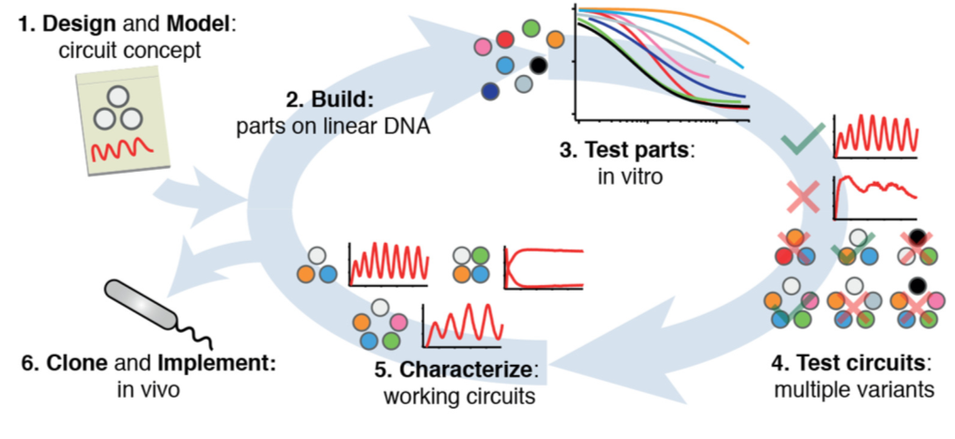
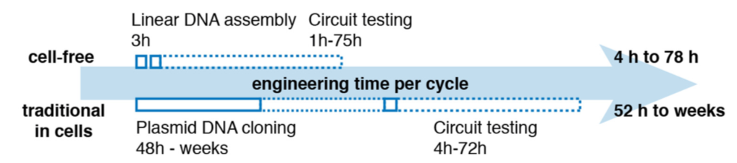
Rapid prototyping
Niederholtmeyer et al. eLife 2015.

Slide 59
Diagnostic

Slide 60
Lab
Cell-free
on
Synthetic Biology

Slide 61
Schedule
 | Lecture | Project
Week 1 | Introduction to PURE
Week 2 | Microbiology | Group allocation
Week 3 | Genetics
Week 4 | Protein purification
Week 5 | Onepot PURE protein production | Discussion of project
Week 6 | Onepot PURE protein purification | Discussion of project
Week 7 | Onepot PURE protein adjustment | Project presentation
Week 8 | Ribosome production | Project presentation
Week 9 | Ribosome purification | Order gene blocks for student
Week 10 | Ribosome adjustment | Project
Week 11 | PURE functional test | Project
Week 12 |  | Project
Week 13 |  | Project presentation
Week 14 | Final Exam | Final Exam
Grading method
Attendance | 25%
Log Book | 30%
Project | 25%
Final exam | 20%

Slide 62
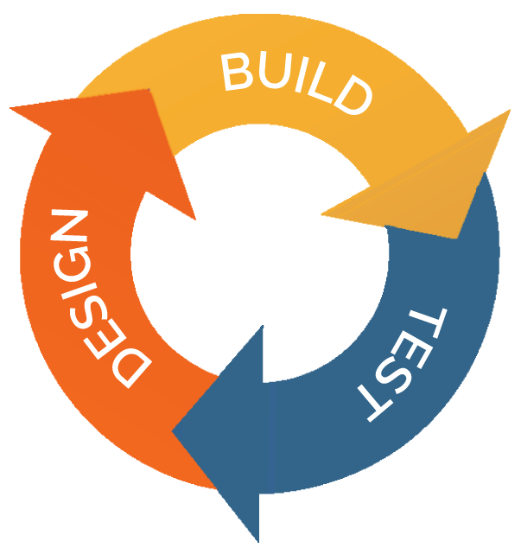
Project
Structure of report
Introduction
Method
Result
Discussion

Slide 63
Project example 1- Design a reporter
Ex: Fluorescent protein
,ß-galactosidase
Reporter

Slide 64
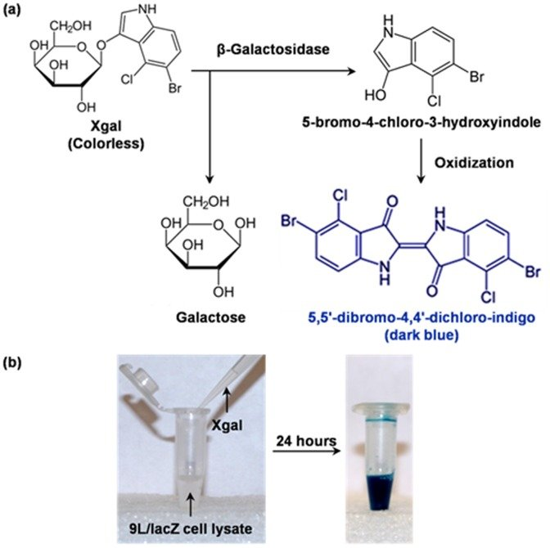
Project example 1- Design a reporter

Slide 65
Project example 2 – Design a zinc finger protein
ZF BS 1
Reporter

Slide 66
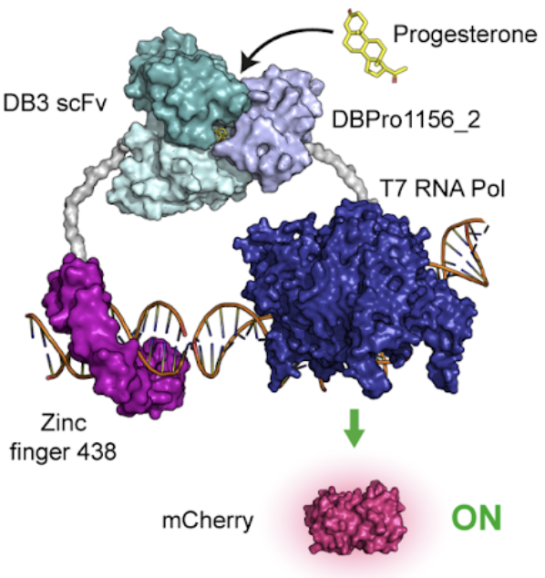
Project example 3- Design a diagnostic tool
Drug
Diagnostic PURE
Reporter
Marchand, Anthony, et al. "Targeting protein-ligand neosurfaces using a generalizable deep learning approach." bioRxiv (2024): 2024-03.
Drug induce transcription translation

Slide 67
What we will provide for project?
1-2 gene fragments you design (<1000bp)
Reagents in LBNC (discuss with TA)
Small molecule sensor protein
Fluorescent protein DNA fragments
Instruments in LBNC and DLL lab
Plate reader
Gel imager

Slide 68
What do you have to do?
2 presenations (before and after the project)
1 project report (per group)

Slide 69
Schedule
 | Lecture | Project
Week 1 | Introduction to PURE
Week 2 | Microbiology | Group allocation
Week 3 | Genetics
Week 4 | Protein purification
Week 5 | Onepot PURE protein production | Discussion of project
Week 6 | Onepot PURE protein purification | Discussion of project
Week 7 | Onepot PURE protein adjustment | Project presentation
Week 8 | Ribosome production | Project presentation
Week 9 | Ribosome purification | Order gene blocks for student
Week 10 | Ribosome adjustment | Project
Week 11 | PURE functional test | Project
Week 12 |  | Project
Week 13 |  | Project presentation
Week 14 | Final Exam | Final Exam
Grading method
Attendance | 25%
Log Book | 30%
Project | 25%
Final exam | 20%

Slide 70
Other reading materials
Meng, F., Ellis, T. The second decade of synthetic biology: 2010–2020. Nat Commun 11, 5174 (2020). https://doi.org/10.1038/s41467-020-19092-2
John Glass’s talk about minimal cell : https://www.youtube.com/watch?v=Qzv6j0HcNFo&t=3914s&ab_channel=Build-a-Cell
Onepot PURE : A Simple, Robust, and Low-Cost Method To Produce the PURE Cell-Free System.
Shimizu, Y., Inoue, A., Tomari, Y. et al. Cell-free translation reconstituted with purified components. Nat Biotechnol 19, 751–755 (2001). https://doi.org/10.1038/90802

